Slide 1
Chapter 6
How to script the DOM with JavaScript

Slide 2
Objectives (part 1)
Applied
Develop DOM scripting applications that work with forms and controls, including applications that add nodes to the DOM.
Use Chrome’s developer tools to view the changes that JavaScript has made to the DOM.
Knowledge
Describe the use of the DOM in JavaScript applications.
Describe these properties of the Node interface for the DOM: parentNode, childNodes, firstChild, lastChild, nextElementSibling, nodeValue, and textContent.
Describe these methods of the Document interface for the DOM: querySelector() and querySelectorAll().
Describe these methods of the Element interface for the DOM: hasAttribute(), getAttribute(), setAttribute(), and removeAttribute().

Slide 3
Objectives (part 2)
Explain how the DOM HTML specification can simplify coding when compared to the DOM Core specification.
Describe how to use the classList property of the Element interface.
Describe the use of a form that has a submit button and a reset button.
Describe the use of Textbox, Textarea, Select, Radio, and Checkbox objects.
Describe these methods for working with forms and controls: submit(), reset(), focus(), blur(), and select().
Describe these events for working with controls: focus, blur, click, dblclick, change, and select.
Describe the process of using the appendChild() and insertBefore() methods of the Node interface to add nodes to the DOM.

Slide 4
The code for a web page
<!DOCTYPE html>
<html>
<head>
<title>Join Email List</title>
</head>
<body>
<h1>Please join our email list</h1>
<h2>hi world</h2>
<form id="email_form" name="email_form"
action="join.html" method="get">
<label for="email_address">Email Address:</label>
<input type="text" id="email_address"
name="email_address">
<span id="email_error">*</span><br>
</form>
</body>
</html>

Slide 5
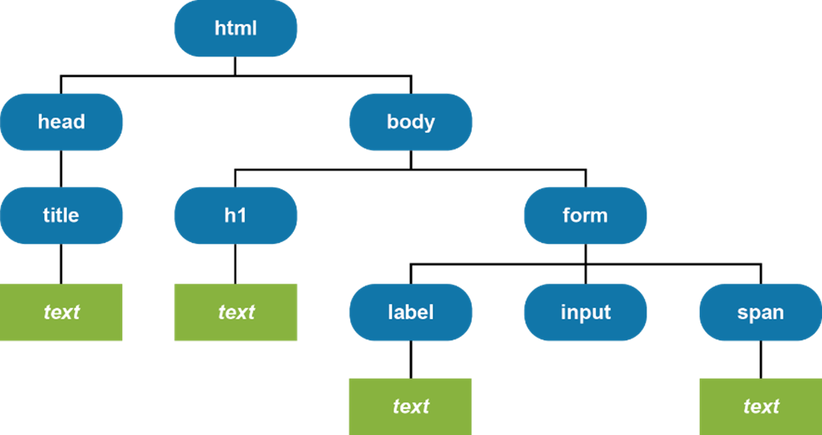
The Document Object Model for the web page
Chrome - JavaScript Engine

Slide 6
The DOM nodes commonly used
Document
Element
Attr
Text

Slide 7
Some of the properties of the Node interface
parentNode
childNodes
firstChild
lastChild
nextElementSibling
nodeValue
textContent

Slide 8
An HTML span element with three child elements
<span><b>Welcome </b><u>Back</u><i>!</i></span>
How to get an Element object for the span element
const span = document.querySelector("span");

Slide 9
How to get the text from the span element
With the nodeValue property
const bElemText = span.firstChild.firstChild.nodeValue;
const uElemText =
span.firstChild.nextElementSibling.firstChild.nodeValue;
const iElemText = span.lastChild.firstChild.nodeValue;
console.log(bElemText + uElemText + iElemText);
// displays Welcome Back!
With the textContent property
const spanText = span.textContent;
console.log(spanText);
// displays Welcome Back!

Slide 10
How to set the text of the span element’s first child element
span.firstChild.textContent = "Hurry ";
console.log(span.textContent);
// displays Hurry Back!
How to set the text of the span element
span.textContent = "Hi";
// replaces all child elements with a text node
console.log(span.textContent);
// displays "Hi"

Slide 11
Common methods of the Document and Element interfaces
querySelector(selector)
querySelectorAll(selector)
Common methods of the Element interface
hasAttribute(name)
getAttribute(name)
setAttribute(name,value)
removeAttribute(name)

Slide 12
How to create an array of all <a> tags in a document
const links = document.querySelectorAll("a");

Slide 13
An HTML ul element
<ul id="image_list">
<li><img src="images/lion.png"></li>
<li><img src="images/tiger.png"></li>
</ul>
How to get an array of all li elements within the ul element
const list = document.querySelector("#image_list");
const items = list.querySelectorAll("li");

Slide 14
How to test for and get an attribute
if ( list.hasAttribute("class") ) {
const classAttribute = list.getAttribute("class"));
}
How to set an attribute
list.setAttribute("class", "open");
How to remove an attribute
list.removeAttribute("class");

Slide 15
The URL for the DOM HTML specification
www.w3.org/TR/DOM-Level-2-HTML/html.html

Slide 16
Typical properties available with the DOM HTML specification
Element Property Attribute
all id The id attribute
title The title attribute
className The class attribute. To set multiple class names, separate the names with spaces.
tagName The name of the tag, like div, h1, h2, a, or img.
<a> href The href attribute
img src The src attribute
alt The alt attribute
input disabled The disabled attribute

Slide 17
How the DOM HTML specification can simplify your code
How to get and set an img tag src attribute with the DOM core specification
const imageElement = $("#image");
alert(imageElement.getAttribute(src));
imageElement.setAttribute(src, "lion.jpg");
How to get and set the same attribute with the DOM HTML specification
alert(imageElement.src);
imageElement.src = "lion.jpg";

Slide 18
Other examples of using the DOM HTML specification (part 1)
How to get the id attribute of the first element in an array
const links = document.querySelectorAll("a");
const firstLinkId = links[0].id);
How to get the href attribute of an <a> element
const target = $("#first_link").href;
How to set and get the class attribute of an element with two class names
$("div").className = "open plus";
const classNames = $("div").className;

Slide 19
Other examples of using the DOM HTML specification (part 2)
How to get the tag attribute of the first element in an array
const links = document.querySelectorAll("a");
const tagName = links[0].tagName; // tagName = "a"
How to disable and enable an element
$("#btnPlay").disabled = true;
$("#btnPlay").disabled = false;

Slide 20
Another property of the Element interface
classList
Common properties of the DOMTokenList object
length
value
Common methods of the DOMTokenList object
contains(className)
add(className)
remove(className)
replace(oldName,newName)
toggle(className)

Slide 21
An HTML label element
<h2 class="first">Welcome to our website!</h2>
How to get an Element object for the label element
const hdg2 = document.querySelector("h2");
How to add a CSS class to the Element object
hdg2.classList.add("blue");
How to replace a CSS class with another CSS class
hdg2.classList.replace("blue", "red");
How to remove a CSS class
hdg2.classList.remove("red");

Slide 22
How to toggle a CSS class
hdg2.classList.toggle("blue");
hdg2.classList.toggle("blue");
hdg2.classList.toggle("blue");
How to check for a CSS class
if (hdg2.classList.contains("blue")) {
hdg2.classList.add("bold");
}

Slide 23
Terms
Document Object Module (DOM)
node
DOM Core specification
interface
DOM scripting
DOM HTML specification

Slide 24
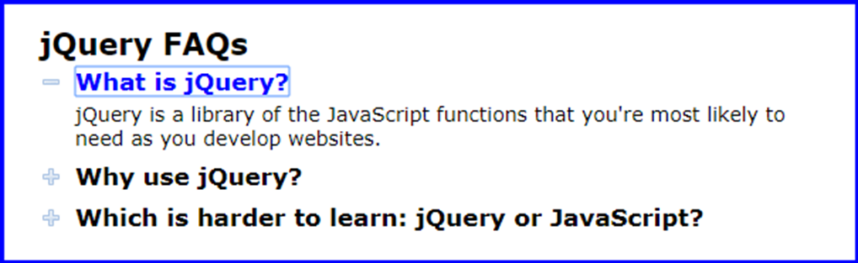
The FAQs application in a browser

Slide 25
The HTML for the FAQs application (part 1)
<body>
<main id="faqs">
<h1>jQuery FAQs</h1>
<h2><a href="#">What is jQuery?</a></h2>
<div>
<p>jQuery is a library of the JavaScript
functions that you're most likely to need as you develop websites.</p>
</div>
<h2><a href="#">Why use jQuery?</a></h2>
<div>
<p>Three reasons:</p>
<ul>
<li>It's free.</li>
<li>It lets you get more done in less time.</li>
<li>It's cross-browser compatible.</li>
</ul>
</div>

Slide 26
The HTML for the FAQs application (part 2)
<h2><a href="#">Which is harder to learn: jQuery
or JavaScript?</a></h2>
<div>
<p>For many things, jQuery is easier to learn
than JavaScript. But remember that jQuery
is JavaScript.</p>
</div>
</main>
<script src="faqs.js"></script>
</body>

Slide 27
The CSS for the FAQs application
a {
color: black;
text-decoration: none;
}
a:focus, a:hover {
color: blue;
}
h2 {
cursor: pointer;
background: url(images/plus.png) no-repeat left center;
}
h2.minus {
background: url(images/minus.png) no-repeat left center;
}
div {
display: none;
}
div.open {
display: block;
}

Slide 28
The JavaScript for the FAQs application (part 1)
// the event handler for the click event
// of each h2 element
const toggle = evt => {
// get the clicked h2
const h2Element = evt.currentTarget;
// get h2's sibling div
const divElement = h2Element.nextElementSibling;
h2Element.classList.toggle("minus");
divElement.classList.toggle("open");
// cancel default action of h2's child <a>
evt.preventDefault();
};

Slide 29
The JavaScript for the FAQs application (part 2)
document.addEventListener("DOMContentLoaded", () => {
// get the h2 tags
const h2Elements =
document.querySelectorAll("#faqs h2");
// attach event handler for each h2 tag
for (let h2Element of h2Elements) {
h2Element.addEventListener("click", toggle);
}
// set focus on first h2 tag's <a> tag
h2Elements[0].firstChild.focus();
});

Slide 30
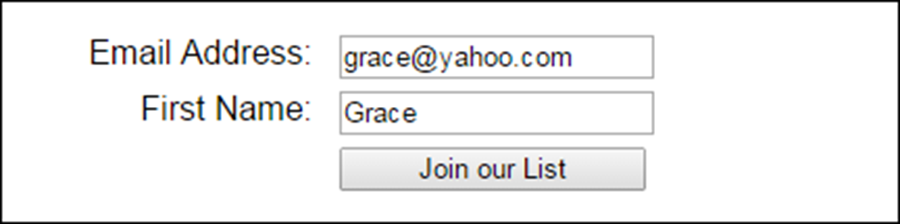
A form in a web browser

Slide 31
The HTML for the form
<form id="email_form" name="email_form"
action="join.php" method="get">
<label for="email_address">Email Address:</label>
<input type="text" id="email_address"
name="email_address"><br>
<label for="first_name">First Name:</label>
<input type="text" id="first_name"
name="first_name"><br>
<label>&nbsp;</label>
<input type="submit" id="join_list"
value="Join our List"><br>
</form>

Slide 32
The URL that’s sent when the form is submitted with the “get” method
join.php?email_address=grace%40yahoo.com&first_name=Grace

Slide 33
Attributes of the form element
name
action
method

Slide 34
Terms related to forms
form
control (or field)
submit button
reset button
data validation

Slide 35
Property of a Textbox, Textarea, or Select object
value

Slide 36
HTML code for a text box, text area, and select list
<label for="name">First Name:</label>
<input type="text" name="name" id="name"><br>
<label for="comment">Comment:</label>
<textarea name="comment" id="comment" rows="5"
cols="40"></textarea><br>
<label for="country">Country:</label>
<select name="country" id="country">
<option value=""></option>
<option value="usa">USA</option>
<option value="can">Canada</option>
<option value="mex">Mexico</option>
</select><br>

Slide 37
JavaScript code to get the text box, text area, and select list values
const name = $("#name").value;
const comment = $("#comment").value;
if (name.length == 0) {
alert("Please enter a name."); }
if (comment.length == 0) {
alert("Please enter a comment."); }
const country = $("#country").value;
if (country == "usa") {
/* USA processing */ }
else if (country == "can") {
/* Canada processing */ }
else if (country == "mex") {
/* Mexico processing */ }
else {
alert("Please select a country."); }

Slide 38
JavaScript code to set the text box, text area, and select list values
$("#country").value = "";
$("#name").value = "";
$("#comment").value = "";

Slide 39
Two properties of a Radio or Checkbox object
value
checked

Slide 40
HTML code for two radio buttons and a check box
<label>Contact me by:</label>
<input type="radio" name="contact" id="text" value="text" checked>Text
<input type="radio" name="contact" id="email"
value="email">Email<br>
<label>Terms of Service:</label>
<input type="checkbox" name="accept" id="accept"
value="accept">I accept<br>

Slide 41
JavaScript code to get the radio button and check box values
let contact = null;
if ($("#text").checked) {
contact = $("#text").value;
}
if ($("#email").checked) {
contact = $("#email").value;
}
if (contact == "text") { /*text processing*/ }
else if (contact == "email") { /*email processing*/ }
else { alert("You must select a contact method"); }
if ($("accept").checked) {
/*accept processing*/
}
else {
alert("You must accept our terms of service.");
}

Slide 42
JavaScript code to set the radio button and check box values
$("#text").checked = false;
$("#email").checked = false;
$("#accept").checked = true;

Slide 43
Two methods that are commonly used with forms
submit()
reset()

Slide 44
Three methods that are commonly used with controls
focus()
blur()
select()

Slide 45
Common control events
focus
blur
click
dblclick
change
select

Slide 46
Statements that use the reset() and submit() methods
$("#registration_form").reset();
$("#registration_form").submit();

Slide 47
An event handler for the change event of a select list
const investmentChange = () => {
calculateClick(); // call valculateClick()
$("#investment").blur(); // remove focus from list
};

Slide 48
An event handler for the dblclick event of a text box
const yearsDblclick = () => {
$("#years").value = ""; // clear text box
};

Slide 49
A DOMContentLoaded event handler that attaches other event handlers
document.addEventListener("DOMContentLoaded", () => {
$("#investment").addEventListener(
"change", investmentChange);
$("#years").addEventListener(
"dblclick", yearsDblclick);
$("#years").focus();
};

Slide 50
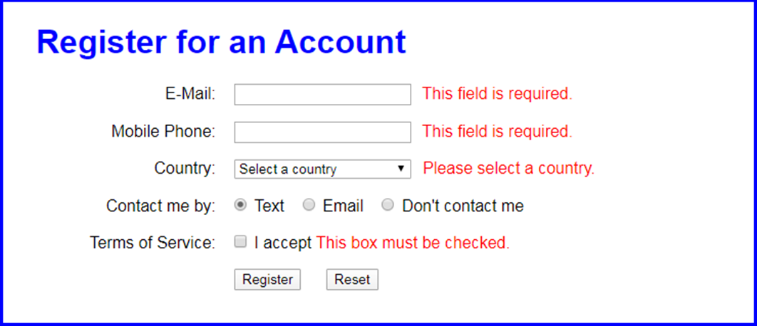
The Register application

Slide 51
The HTML for the form and controls (part 1)
<h1>Register for an Account</h1>
<form action="register_account.html" method="get">
<div>
<label for="email_address">E-Mail:</label>
<input type="text" name="email_address"
id="email_address">
<span>*</span></div>
<div>
<label for="phone">Mobile Phone:</label>
<input type="text" name="phone" id="phone">
<span>*</span></div>
<div>
<label for="country">Country:</label>
<select name="country" id="country">
<option value="">Select a country</option>
<option>USA</option>
<option>Canada</option>
<option>Mexico</option>
</select>
<span>*</span></div>

Slide 52
The HTML for the form and controls (part 2)
<div>
<label>Contact me by:</label>
<input type="radio" name="contact" id="text"
value="text" checked>Text
<input type="radio" name="contact" id="email"
value="email">Email
<input type="radio" name="contact" id="none"
value="none">Don't contact me</div>
<div>
<label>Terms of Service:</label>
<input type="checkbox" name="terms" id="terms"
value="yes">I accept
<label>&nbsp;</label><span>*</span></div>
<div>
<label>&nbsp;</label>
<input type="button" id="register"
value="Register">
<input type="button" id="reset_form"
value="Reset"></div>
</form>

Slide 53
The JavaScript for the Register app (part 1)
const $ = selector => document.querySelector(selector);
const processEntries = () => {
const email = $("#email_address");
const phone = $("#phone");
const country = $("#country");
const terms = $("#terms");
let isValid = true;
if (email.value == "") {
email.nextElementSibling.textContent =
"This field is required.";
isValid = false;
} else {
email.nextElementSibling.textContent = "";
}
if (phone.value == "") {
phone.nextElementSibling.textContent =
"This field is required.";
isValid = false;
} else {
phone.nextElementSibling.textContent = "";
}

Slide 54
The JavaScript for the Register app (part 2)
if (country.value == "") {
country.nextElementSibling.textContent =
"Please select a country.";
isValid = false;
} else {
$("#country").nextElementSibling.textContent = "";
}
if (terms.checked == false) {
terms.nextElementSibling.textContent =
"This box must be checked.";
isValid = false;
} else {
terms.nextElementSibling.textContent = "";
}
if (isValid == true) {
$("form").submit();
}
};

Slide 55
The JavaScript for the Register app (part 3)
const resetForm = () => {
$("form").reset();
$("#email_address").nextElementSibling.textContent = "*";
$("#phone").nextElementSibling.textContent = "*";
$("#country").nextElementSibling.textContent = "*";
$("#terms").nextElementSibling.textContent = "*";
$("#email_address").focus();
};
document.addEventListener("DOMContentLoaded", () => {
$("#register").addEventListener("click", processEntries);
$("#reset_form").addEventListener("click", resetForm);
$("#email_address").focus();
});

Slide 56
Two more methods of the Document interface
createElement(element)
createTextNode(value)

Slide 57
Five more methods of the Node interface
appendChild(node)
insertBefore(new,existing)
replaceChild(new,existing)
removeChild(node)
remove()

Slide 58
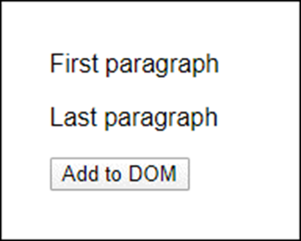
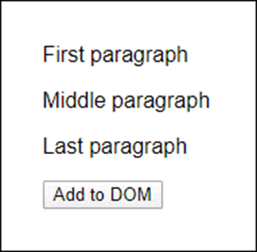
A button that adds a new <p> element to the DOM
Before button is clicked After button is clicked
The HTML
<p>First paragraph</p>
<p>Last paragraph</p>
<input type="button" id="add" value="Add to DOM">

Slide 59
The click event handler for the button
$("#add").addEventListener("click", () => {
// create a new <p> tag
const newParagraph = document.createElement("p");
// create a new text node and add it to the new <p> tag
const text = document.createTextNode("Middle paragraph");
newParagraph.appendChild(text);
// get the first <p> tag in the document and its parent
const firstParagraph = $("p");
const parent = firstParagraph.parentNode;
// insert the new <p> tag after the first <p> tag (that is,
// before the element that comes after the first <p> tag)
parent.insertBefore(
newParagraph, firstParagraph.nextElementSibling);
});

Slide 60
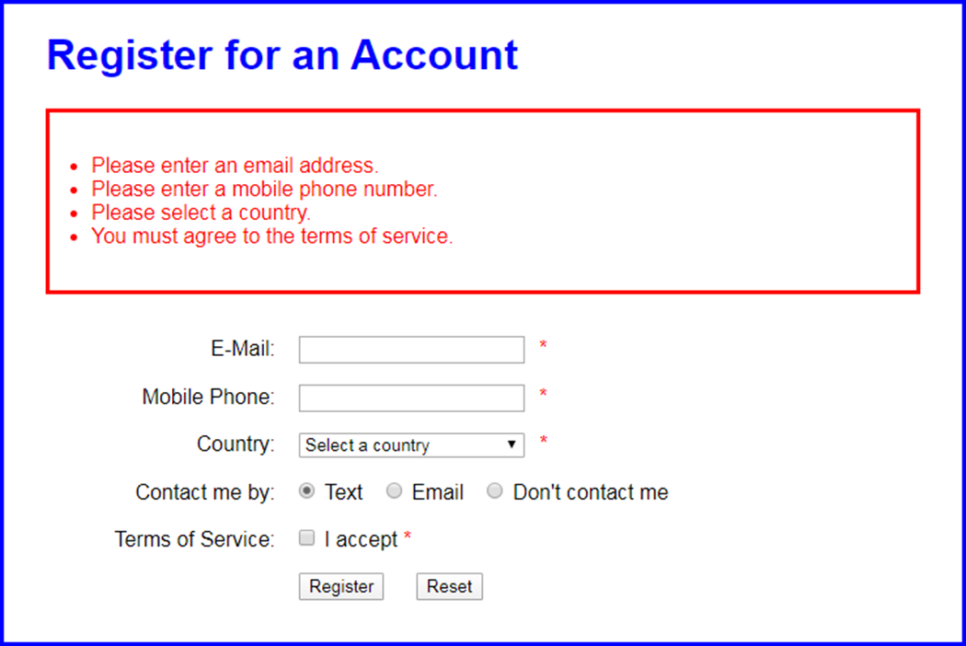
The updated Register application

Slide 61
The CSS for the error messages
.messages {
border: 3px solid red;
color: red;
padding: 2em;
margin-bottom: 2em;
}

Slide 62
The updated JavaScript (part 1)
const displayErrorMsgs = msgs => {
// create new ul tag
const ul = document.createElement("ul");
ul.classList.add("messages");
// create li tag for each error message and add to ul tag
for (let msg of msgs) {
const li = document.createElement("li");
const text = document.createTextNode(msg);
li.appendChild(text);
ul.appendChild(li);
}
// If no ul element yet, add it before form tag.
// Otherwise, replace it.
const node = $("ul");
if (node == null) {
const form = $("form");
form.parentNode.insertBefore(ul, form);
}
else {
node.parentNode.replaceChild(ul, node);
}
}

Slide 63
The updated JavaScript (part 2)
const processEntries = () => {
// get form controls to check for validity
const email = $("#email_address");
const phone = $("#phone");
const country = $("#country");
const terms = $("#terms");
// create array for error messages
const msgs = [];
// check user entries for validity
if (email.value == "") {
msgs[msgs.length] = "Please enter an email address."; }
if (phone.value == "") {
msgs[msgs.length] =
"Please enter a mobile phone number."; }
if (country.value == "") {
msgs[msgs.length] = "Please select a country."; }
if (terms.checked == false) {
msgs[msgs.length] =
"You must agree to the terms of service."; }

Slide 64
The updated JavaScript (part 3)
// submit the form or notify user of errors
if (msgs.length == 0) { // no error messages
$("form").submit();
} else {
displayErrorMsgs(msgs);
}
};
const resetForm = () => {
$("form").reset(); // don't need to clear span elements
$("ul").remove(); // remove the error messages
$("#email_address").focus();
};
document.addEventListener("DOMContentLoaded", () => {
$("#register").addEventListener("click", processEntries);
$("#reset_form").addEventListener("click", resetForm);
$("#email_address").focus();
});

